Slide 1
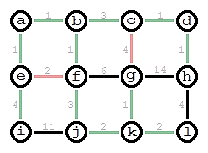
Minimum Spanning Trees
along a weighted graph using
Kruskal’s Algorithm
Shaun Jaeschke & Julian Lee
Notes:
Shaun

Slide 2
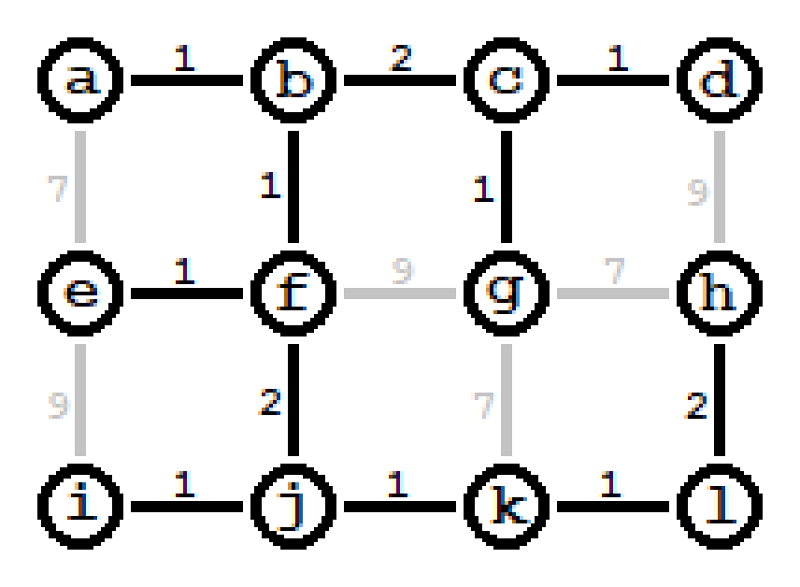
What is an MST? (Minimum Spanning Tree)
- An MST is the tree connecting all nodes in a graph with the minimal total edge length.
- By definition of being a tree, it contains no loops.
- These trees are often useful for network optimization tasks, logistics chains, utilities planning, and infrastructure.
Notes:
Shaun

Slide 3
Who might care about MSTs?
As mentioned earlier any companies dealing with networks and logistics will use some amount of MST logic for optimization in their systems.
Examples include telecommunication companies such as phone carriers and internet service providers, electrical & utility grid services, and logistics & transportation such as Amazon or USPS.
Implementation of Kruskal’s algorithm within 30 minutes has been reported as an interview question at Amazon.
https://www.glassdoor.com/Interview/Implement-kruskal-s-algorithm-in-about-30-minutes-QTN_1966985.htm
Notes:
Julian

Slide 4
Methods for finding an MST
Various algorithms for finding an MST exist. Most of classics are what are considered greedy algorithms; ones that make logically optimal choices at each step and do not reconsider past choices.
One of the classic algorithms is Kruskal’s Algorithm. Its key features include sorting, and utilization of a disjoint-set data structure.
Animation of Kruskal's algorithm on a complete graph with weights based on Euclidean distance
https://en.wikipedia.org/wiki/Minimum_spanning_tree#Algorithms
https://en.wikipedia.org/wiki/Kruskal's_algorithm
Notes:
1st part Shaun
2nd part Julian

Slide 5
Union-Find ADT
- Also known as a disjoint-set data structure, the union-find structure is a data structure that stores a collection of disjoint sets.
- The primary functions of it are adding new sets, merging sets, and finding the representing member of a set.
- This data structure is critical for Kruskal’s Algorithm as it allows for very efficient checking of loops.
- Since union can only be called on two disconnected sets it ensures that no loops will be formed. When a valid union is found it means the edge connecting those two trees is valid.
- The find function allows for efficient checks of two elements sharing a set.
- The find operation runs in near constant time, O(α(n)). (α being the inverse Ackermann function)
https://en.wikipedia.org/wiki/Disjoint-set_data_structure
Notes:
1 & 2 Shaun
3 Julian

Slide 6
Implementation of Kruskal’s Algorithm
1: Collect graph vertices and weighted edges
2: Sort edges by weight
3: Loop through the sorted edges in ascending order and:
3.1: Test if adding an edge would create a loop
3.2: If not, add edge connecting the vertices
4: Once every vertex has been visited terminate the loop as the tree is complete
- All vertices can be considered their own disconnected trees until joined by an edge to another tree.
- Kruskal’s algorithm is considered greedy because it attempts to add all minimal weights first. A minimal weight is only not added if it makes the tree invalid.
- Termination after all vertices are connected is done because any further edge connections would create a loop.
Notes:
Shaun

Slide 7
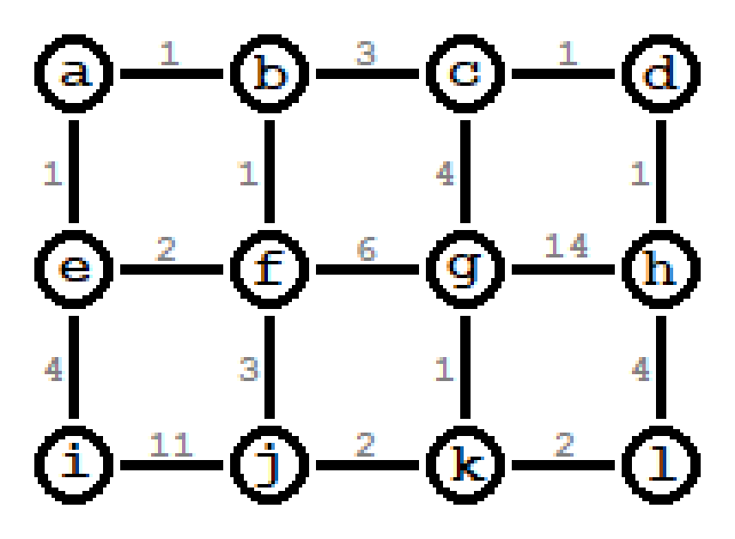
Demonstration
Edge |  |  | Weight
a | — | b | 1
c | — | d | 1
a | — | e | 1
b | — | f | 1
d | — | h | 1
g | — | k | 1
e | — | f | 2
j | — | k | 2
k | — | l | 2
b | — | c | 3
f | — | j | 3
c | — | g | 4
e | — | i | 4
h | — | j | 4
f | — | g | 6
i | — | j | 11
g | — | h | 14
Notes:
Shaun for demonstration
Julian for total weight

Slide 8
GitHub repository & Sources
GitHub repository: https://github.com/ShaunJae/CIS112Final
Glassdoor – Interview question: https://www.glassdoor.com/Interview/Implement-kruskal-s-algorithm-in-about-30-minutes-QTN_1966985.htm
Wikipedia - Minimum Spanning Trees: https://en.wikipedia.org/wiki/Minimum_spanning_tree#Algorithms Wikipedia - Kruskal’s Algorithm: https://en.wikipedia.org/wiki/Kruskal's_algorithm
Wikipedia - Disjoint-Set Data Structure: https://en.wikipedia.org/wiki/Disjoint-set_data_structure
Notes:
Shaun

